Slide 1

Molecular Dynamics Study of Water Diffusivity in Graphene Nanochannels.
By: Abhay Rupareliya and Abhay Gupta
Guided by : Prof. J K Singh

Slide 2

Contents:
What is Graphene sheet?
Why is Graphene sheet is so important?
Objective
Software/Tools used & methodology.
Simulation System of water in a confined box.
Simulation model of water confined between two parallel flat graphene Sheets.
Results : Simulation of water in a confined graphene nanochannel.
Literature review

Slide 3

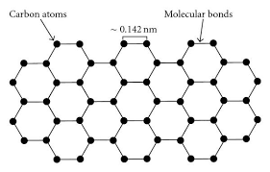
What is Graphene sheet?
Graphene sheets are composed of carbon atoms linked in hexagonal shapes, as shown in the figure.
Each sheet of graphene is only one atom thick and each graphene sheet is considered a single molecule.
Discovery:
Graphene theory first explored by P.R Wallce in 1947.
It was discovered in 2004 in UK.
Over the past few decades, graphene has received a significant amount of attentions.
Fig 1. atomic structure of graphene sheet.
3

Slide 4
Why is Graphene sheet is so important?
High Mechanical strength and has a low density.
Ultimate tensile strength of 130 gigapascals compared to 400 megapascals for structural steel.
Graphene can conduct electricity
The potential uses of Graphene are numerous and diverse, including in electronics, energy storage, water purification, and even biomedical applications.
Graphene is also being explored for use in the creation of new materials and products that are stronger, lighter, and more efficient.
4

Slide 5
Literature review
The simulation was carried out at a temperature of 300 K using the TIP4P model, similar to the MD simulations by In a study by Zhang et al. (2014), the authors investigated the effect of the interlayer distance and temperature on the diffusion behavior of water molecules between two parallel graphene sheets. The results showed that the water diffusivity increases with increasing temperature and also with increasing interlayer distance.
A previous study has attributed the anisotropic diffusivity in nanochannels to the presence of boundary walls that limit the mobility of fluid molecules in the z-direction [3]. This deduction is due to the density profile along the z-direction and the higher number density of water near the graphene walls.
Ref : [1] M. Zhao, X. Yang, X. Yang, Acta Phys. -Chim. Sin. 31, 1489 (2015).
[2] R.J. Mashl, S. Joseph, N.R. Aluru, E. Jakobsson, Nano Lett. 3, 589 (2003).
[3] F. Sofos, T. Karakasidis, A. Liakopoulos, Int. J. Heat. Mass. Transf. 52, 735 (2009).
5

Slide 6
Objective
This work was aimed to investigate the behavior, structure and dynamical properties of water confined between two parallel and flat graphene sheets at different interwall distances.
Study of these systems has become an important area of research with potential applications as development of new nanoscale devices.
Determining the diffusivity of water can help researchers understand how water moves through nanochannel which can have applications such as water filtration, desalination, and energy storage.
6

Slide 7

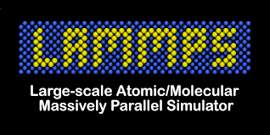
Software/Tools used
Lammps
Packmol
Visualization Molecular Dynamics (VMD)
MS Excel
7

Slide 8

Methodology
The diffusivity can be obtained with the Einstein equation:
$$D=\lim_{t→∞}{\frac{1}{2dNt}}\left(\sum_{j=1}^{N}{{\left[r_{j}\left(t\right)−r_{j}\left(0\right)\right]}^{2}}\right)$$
where $r_{j}$ is the position vector of the $j$th atom, t is the time and d is the dimensionality of the system. So, for 3-D (x-,y- and z-directions)
$$D=\lim_{t→∞}{\frac{1}{6Nt}}\left(\sum_{j=1}^{N}{{\left[r_{j}\left(t\right)−r_{j}\left(0\right)\right]}^{2}}\right)$$
The mean square displacement (MSD) is defined as:
$$MSD=\lim_{t→∞}{\frac{1}{N}}\left(\sum_{j=1}^{N}{{\left[r_{j}\left(t\right)−r_{j}\left(0\right)\right]}^{2}}\right)$$
Therefore, the slope of the MSD determines the diffusivity.
8

Slide 9
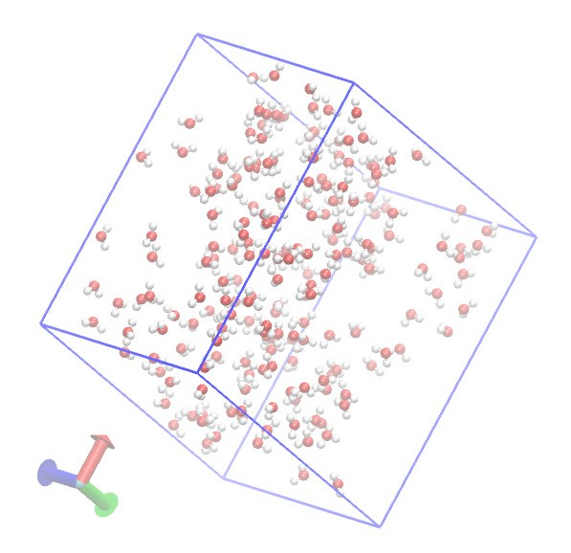
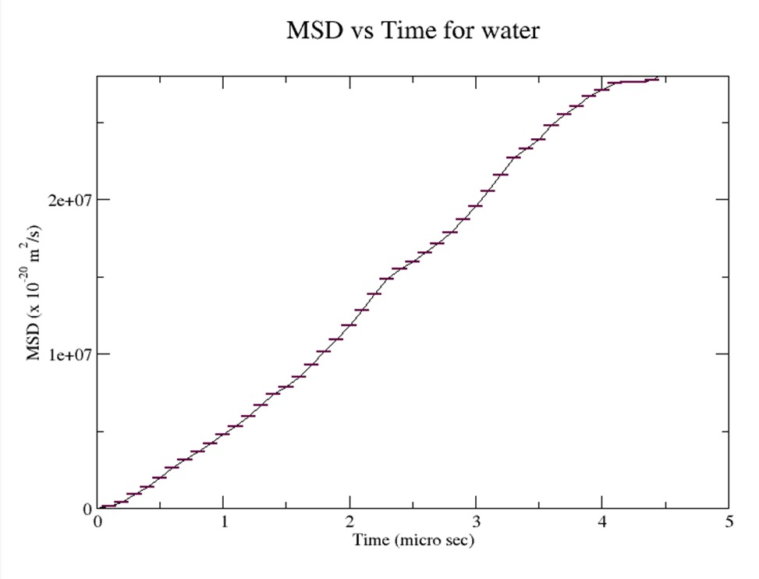
Simulation System of water in a box
Fig 2. Simulation system of water. The box has the size of L x = 30 Å, L y = 30 Å and L z=20 Å.
Fig 3. MSD as a function of time for the water molecules within box region.
Water | From reference | Our simulation result
Diffusivity (m² s⁻ ¹) | 2.62 X 10⁻ ⁹ | 3.08 X 10⁻ ⁹

Slide 10

Simulation Model
The water molecules are initialized from a random distribution
The length and the width of the simulation region are fixed, $L_{x}\text{=}\text{30 Å}$ and $L_{y}\text{=}\text{30 Å}$. The distance between the two graphene sheets varies from 10$\text{Å}$ to 25 $\text{Å}$.
The MD simulations are performed in the NVT ensemble using the LAMMPS.
A Nose-Hoover thermostat is used to maintain the temperature at T=300 K.
The atomic interactions in the MD simulations are modeled with the accepted Lennard-Jones (LJ) potential model.
The common Berthelot–Lorentz mixing rule is used to determine the parameters between carbon and oxygen.
$$σ_{CO}=\frac{σ_{CC}{+σ}_{OO}}{2} \& ε_{CO}=\sqrt{ε_{CC}ε_{OO}}$$
We can obtain the LJ parameters between carbon and oxygen as $σ_{CO}$= 0.3283 nm and $ε_{CO}$=0.0930 kcal/mol.
10

Slide 11
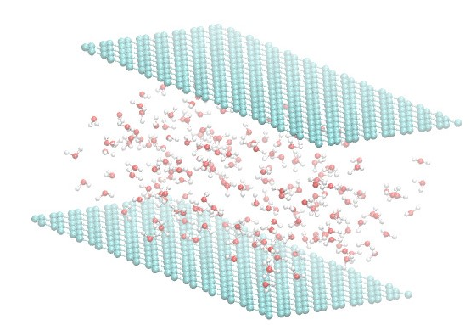
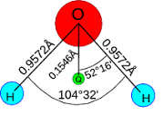
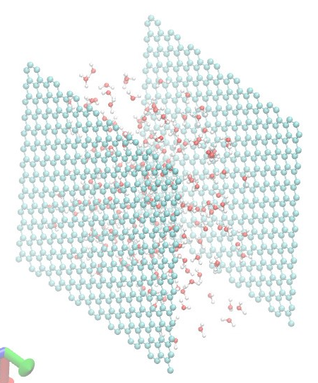
Simulation System of water confined between two Graphene Sheets
a)
b)
TIP4P
c)
Fig 4. a) Simulation Box, b) atomic model of water c)atomic model of graphene

Slide 12
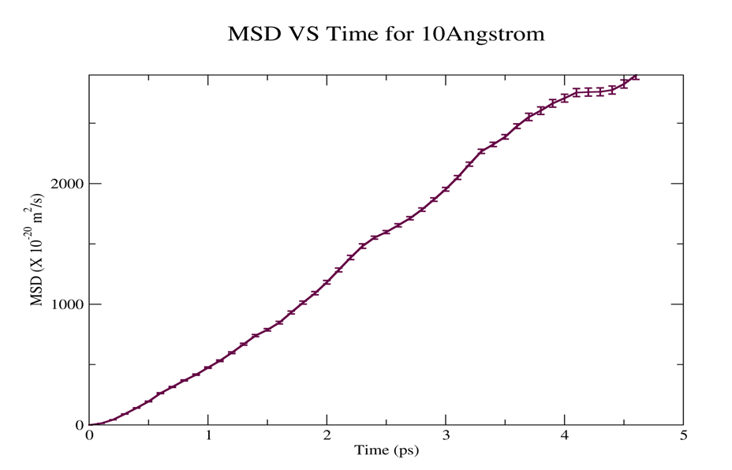
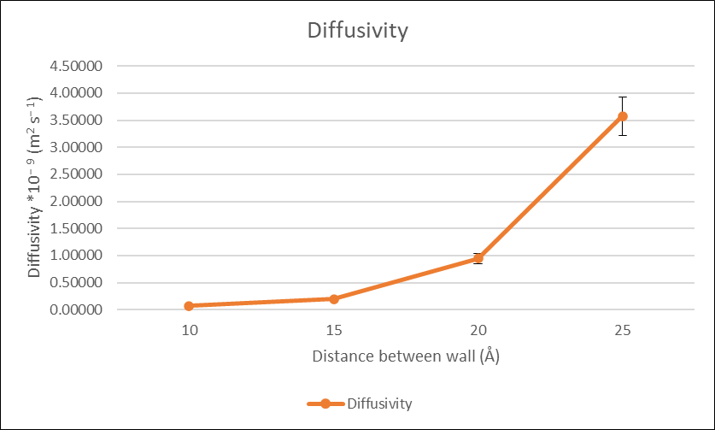
Results : Simulation of water in a confined graphene nanochannel
Fig 5. MSD as a function of time for the water molecules in a confined graphene nanochannel.
Fig 6. Diffusivity as a function of the nanochannel Height
Performing the simulation of water in a confined graphene nanochannel, we got the diffusivity 7.356*10⁻¹¹ m² s⁻ ¹ at distance between the graphene sheet is equal to 10Å.
Now as we see in Fig. 6, on increasing the distance between the graphene sheet diffusivity increases. This is because the interaction between the sheet and water molecules decreases, leading to less confinement and less hindering of the water molecule movement, which can increase its diffusivity.

Slide 13


THANK YOU
Abhay Gupta & Abhay Rupareliya

